Slide 1
Pixel Storm

Slide 2
The idea
T
The main aim of the project is to create an application that helps if somewhere in the country there is fire. They can report the fire and call firemen

Slide 3
Steps of realisation
Idea
GitHub Setup
Organization
Desing
Coding
Execution of presentation & documentation

Slide 4



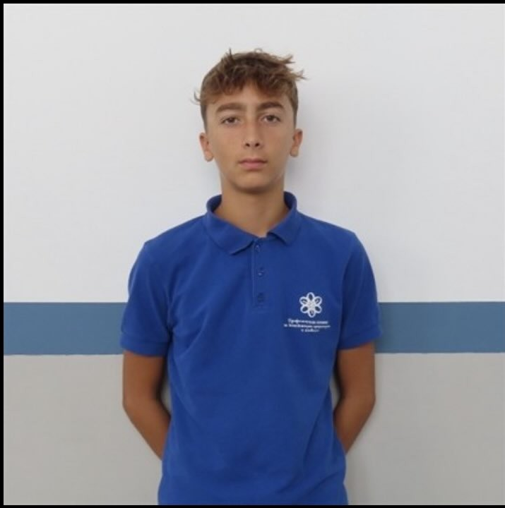
members
Ivan Ivanov
Scrum trainer
Bozhidar Georgiev
Designer
Yavor Velizarov
Frontend developer
Todor Toromanov
Backend developer

Slide 5





Used progams

Slide 6
Lets jump into the project

